Slide 1
Software Development on Java
Dzmitry Marchankau 2023

Slide 2
Functional programming with Java 8
Programming styles
Java 8 features:
Stream API
Lambda functions
Optional
Functional interface

Slide 3
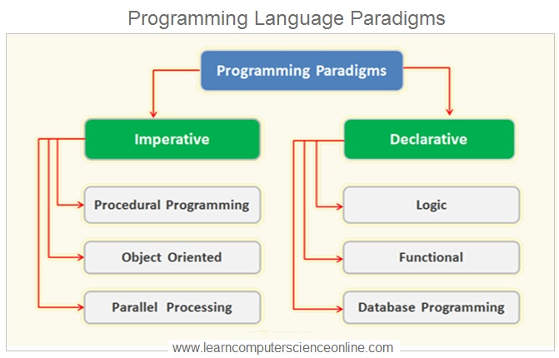
Programming paradigm

Slide 4
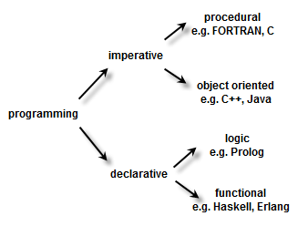
Programming paradigm

Slide 5
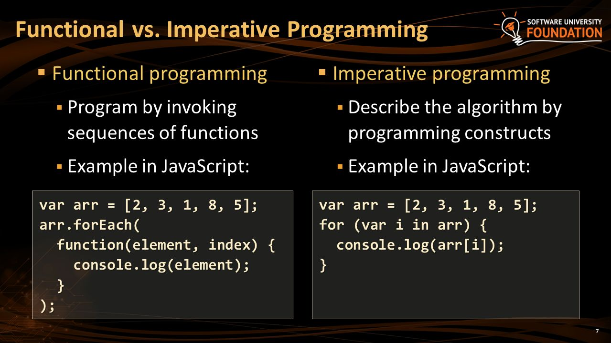
Functional vs imperative

Slide 6
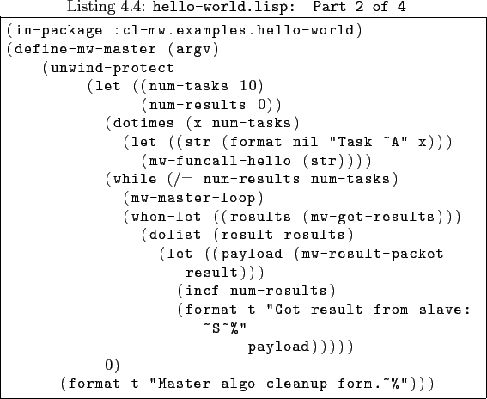
Functional example with Lisp

Slide 7
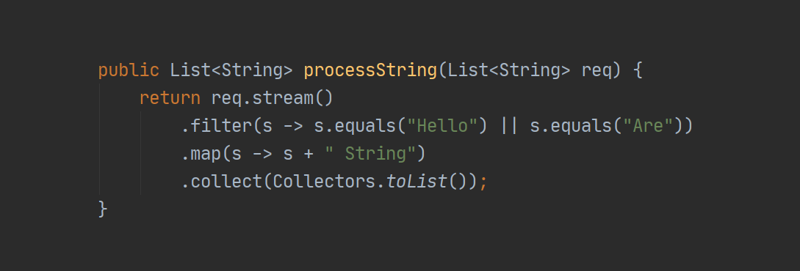
Functional example with Java

Slide 8
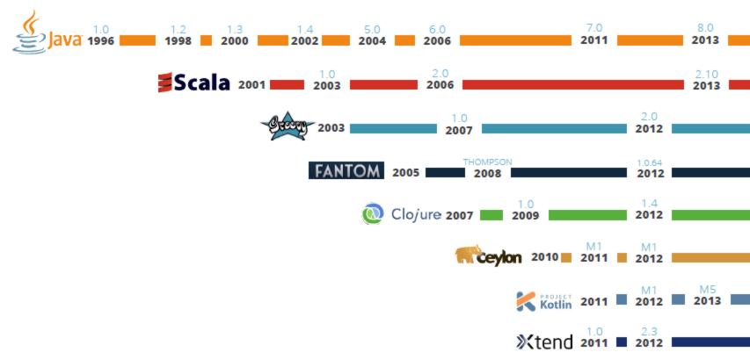
JVM languages

Slide 9
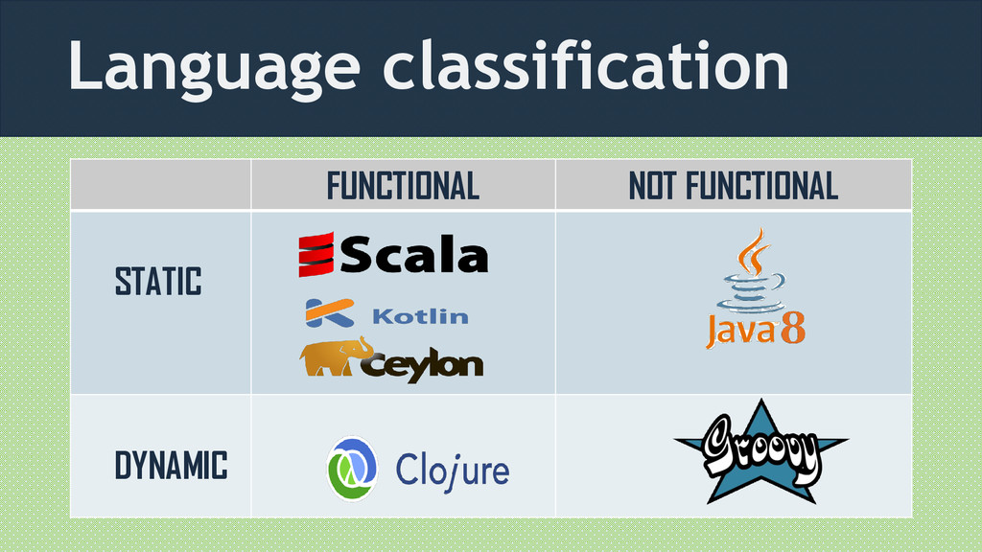
JVM languages

Slide 10
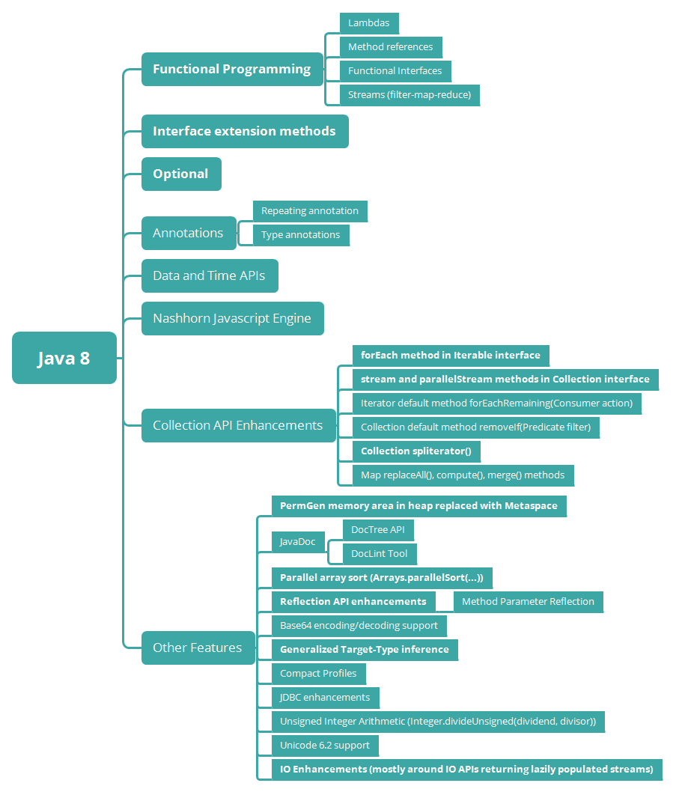
Java 8 new features

Slide 11
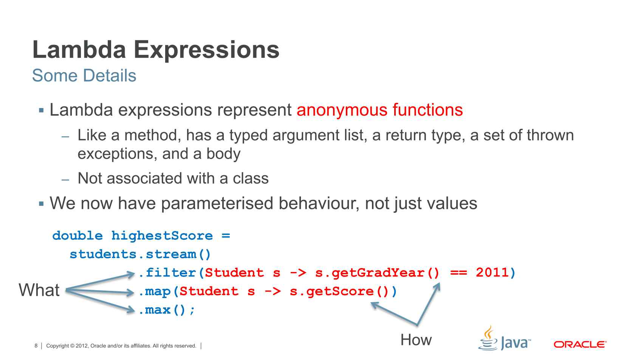
Lambdas

Slide 12
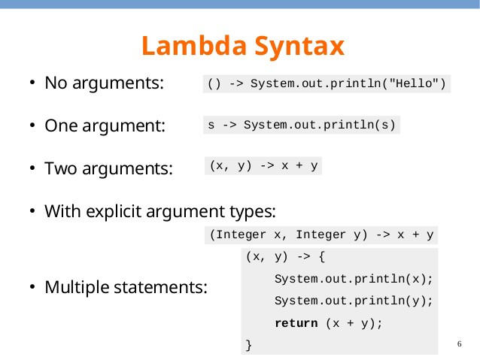
Lambda Syntax

Slide 13
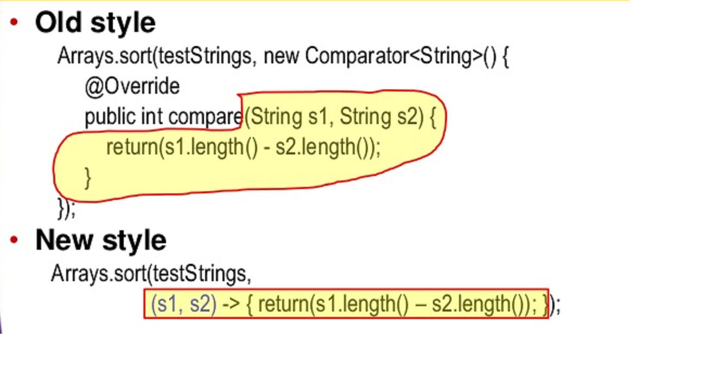
Lambda example

Slide 14
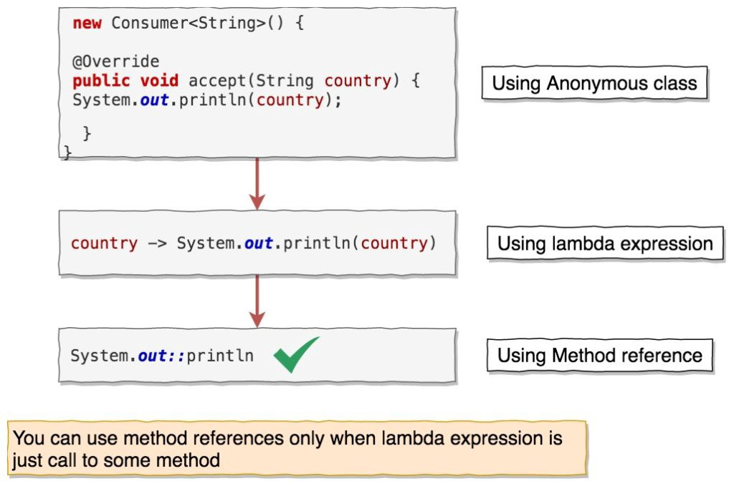
Method references

Slide 15
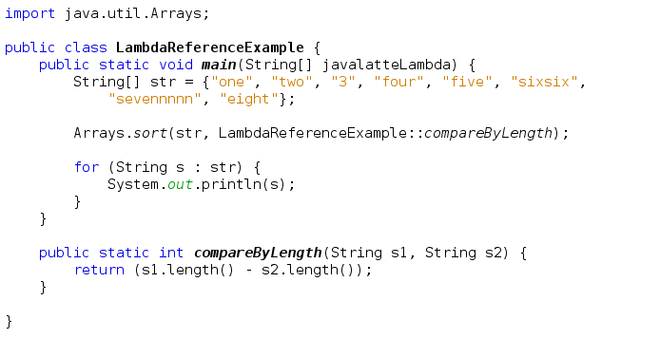
Method reference example

Slide 16
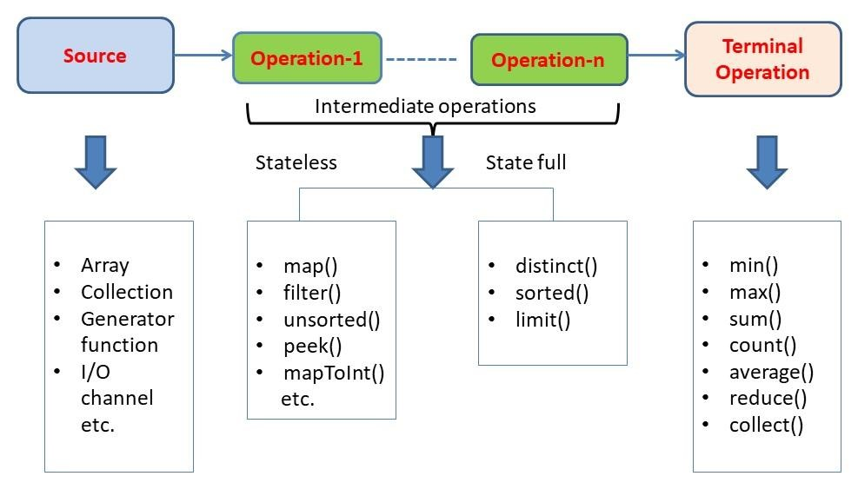
Java Stream API

Slide 17
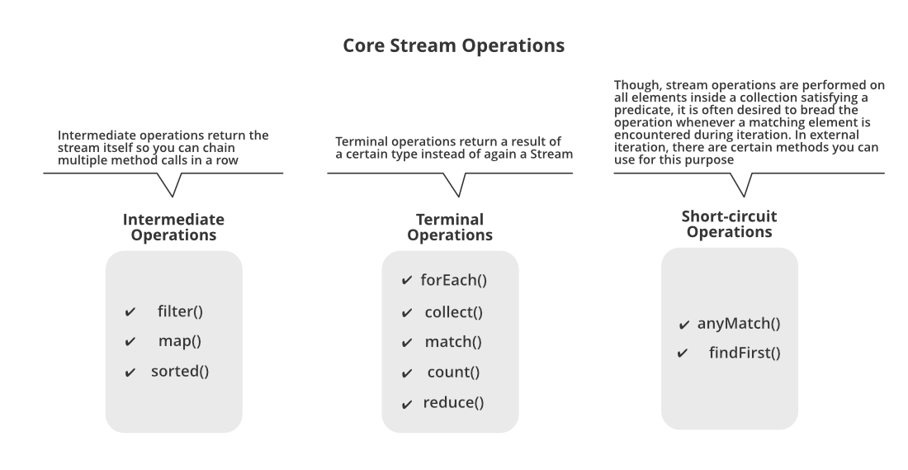
Java Stream operations

Slide 18
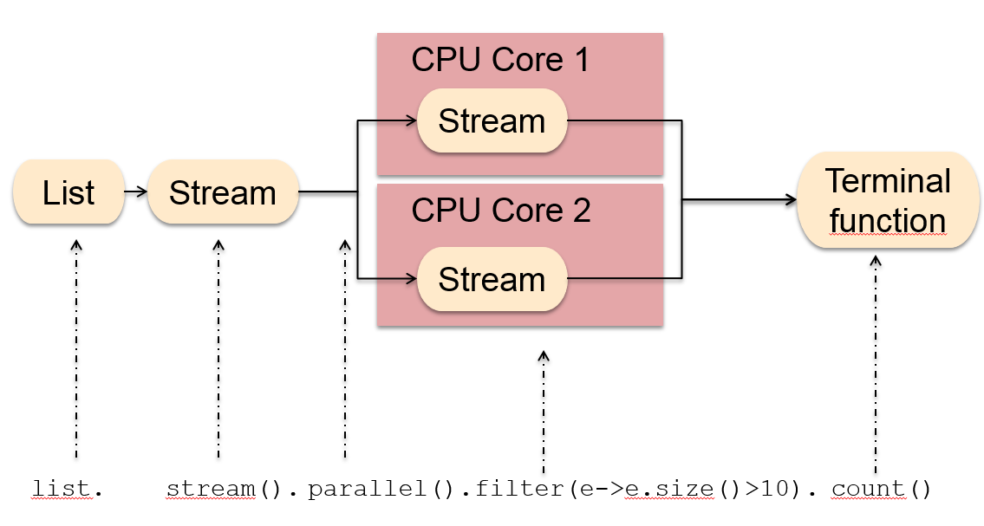
Parallel streams
Notes:
You can parallelise the work you do in a stream in a couple of ways. Firstly you can get a parallel stream directly from your source by calling the parallelStream() method directly, or you can call an intermediate operation on an existing stream which spawns off threads and executes further operations in parallel. One important thing to note is that parallel streams achieve parallelism through threads using the existing common ForkJoinPool. Using parallel streams can cause concurrency issues depending on what you’re doing in your stream as well.

Slide 19
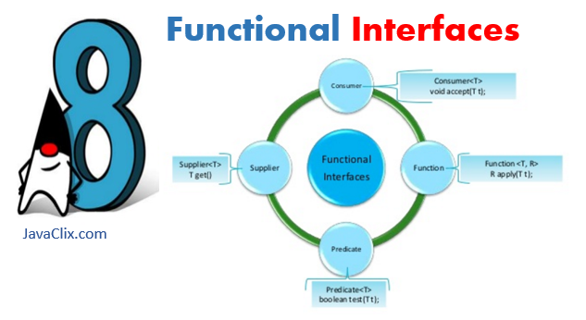
Functional interfaces

Slide 20
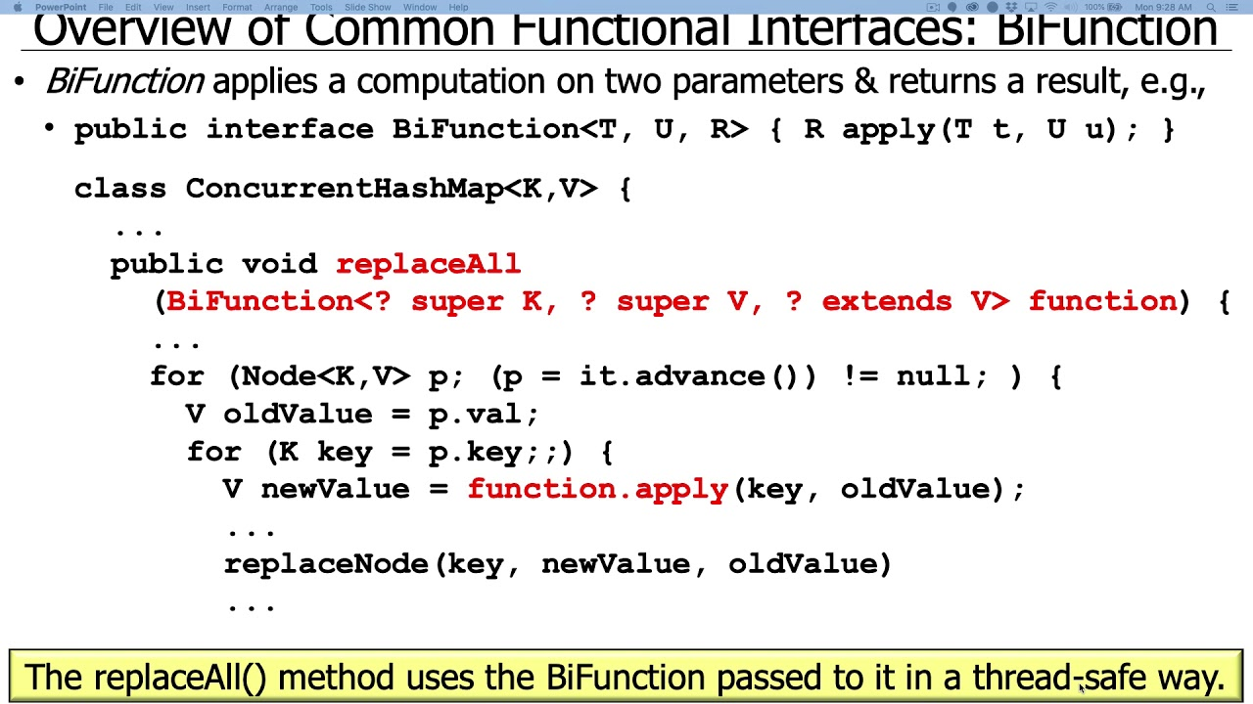
Functional interface example

Slide 21
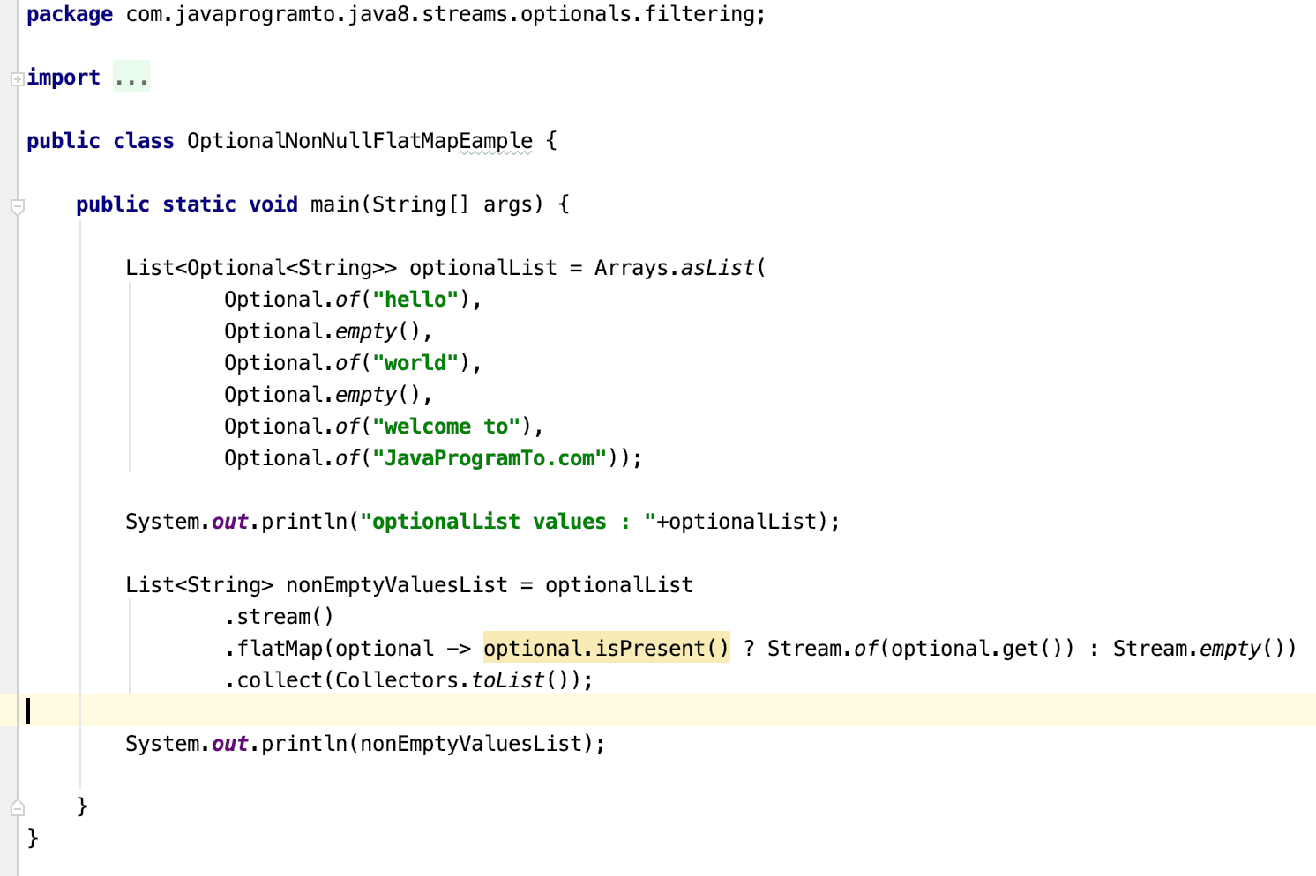
Optional class example

Slide 22
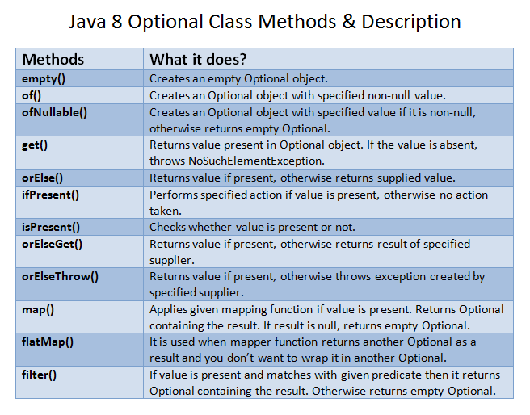
Optional class methods

Slide 23
Questions ?

